Slide 1
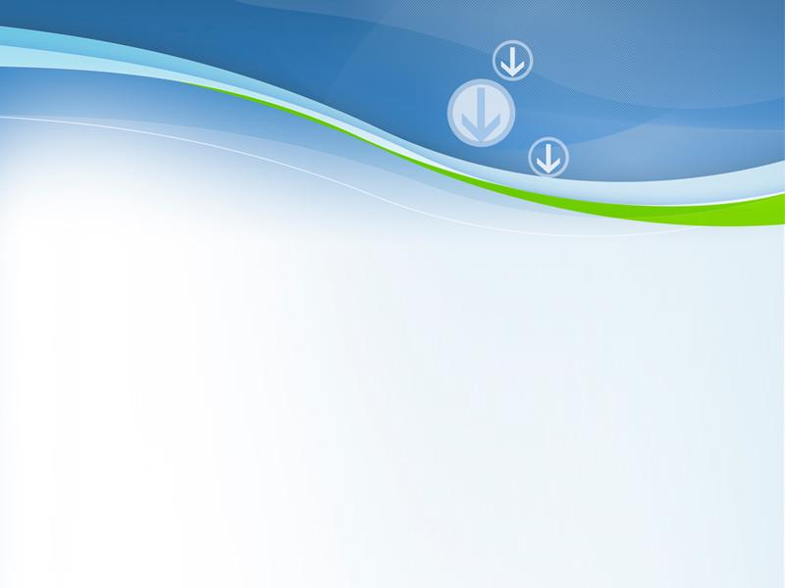
Computer Network
Powerpoint Templates

Slide 2
Outline
Data Link Layer
Types of Framing
Byte count
character-based framing
Bit-oriented framing
Random Multiple Access Control Protocols
Pure ALOHA
Slotted ALOHA
CSMA
CSMA/CD
CSMA/CA

Slide 3
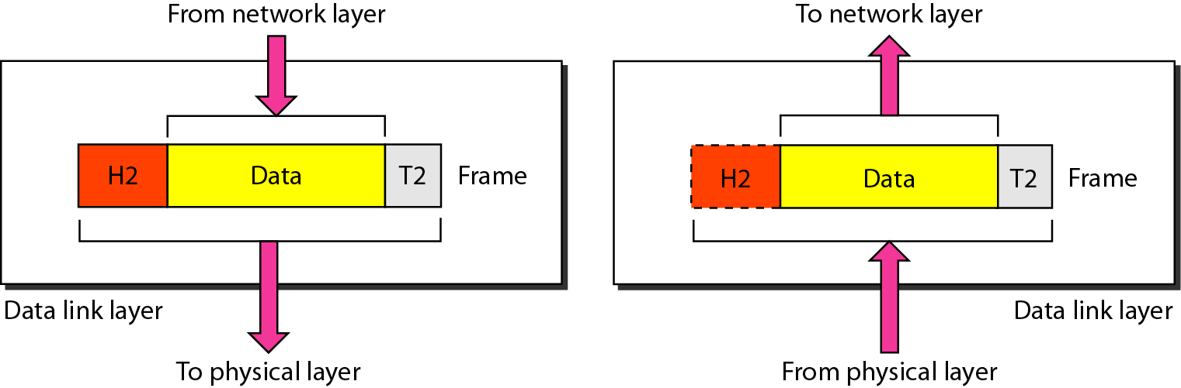
Data Link Layer
The data link layer is responsible for moving frames from one hop (node) to the next

Slide 4
Functions of the Data Link Layer (local focus)
Specific things that DLL does in order to accomplish the general functions of handling errors and regulating data flow
Framing: divides the stream of bits received from the network layer into manageable data units called frames
Error Control: adds reliability to the physical layer by adding mechanisms to detect and retransmit damaged, duplicate, or lost frames. Both detection and correction schemes may be used
Flow Control (imposes a flow control mechanism to prevent sender from “swamping” or overwhelming the receiver which is normally built into the protocol
Media access control determines which device has control over the link at any given time when two or more devices are connected to the same link
Addressing adds a header to the frame to define the addresses of the sender and receiver of the frame

Slide 5
Framing
The data link layer needs to pack bits into frames, so that each frame is distinguishable from another
Deciding, at the receiving end, where frames start and stop and filling idle periods
Types of framing
byte count
character-based framing
bit-oriented framing

Slide 6
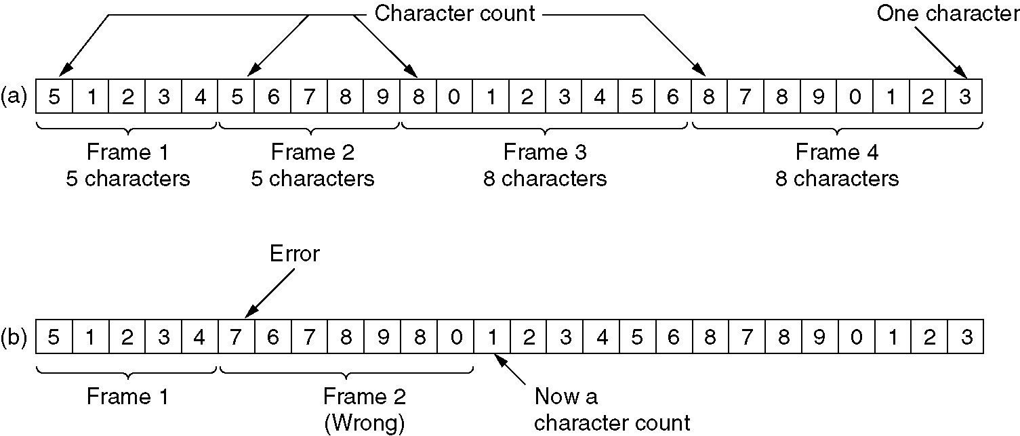
Framing: Byte (length) count
Header contains length of frame
Problems
count may become corrupted
receiver has no way to tell where next frame starts
Example:

Slide 7
Framing: character-based framing
special characters (flag bytes) used with byte stuffing
Two consecutive flag bytes indicate the end of one frame and the start of the next
Thus, if the receiver ever loses synchronization
it can just search for two flag bytes to find the end of the current frame and the start of the next frame
If FLAG byte occurs in data itself (such as in binary data: transmission of photographs or songs)
Interfering problem
Insert ESC byte before each FLAG data byte (byte stuffing)
If ESC byte itself appears in data
Insert another ESC byte before ECS byte of data

Slide 8
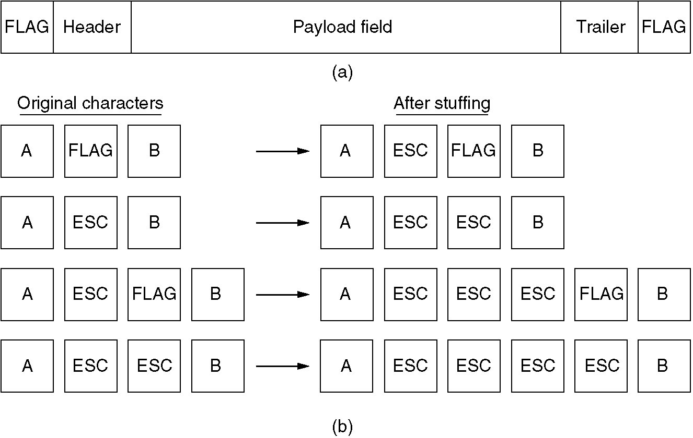
Framing: character-based framing
(a) A frame delimited by flag bytes
(b) Four examples of byte sequences before and after stuffing

Slide 9
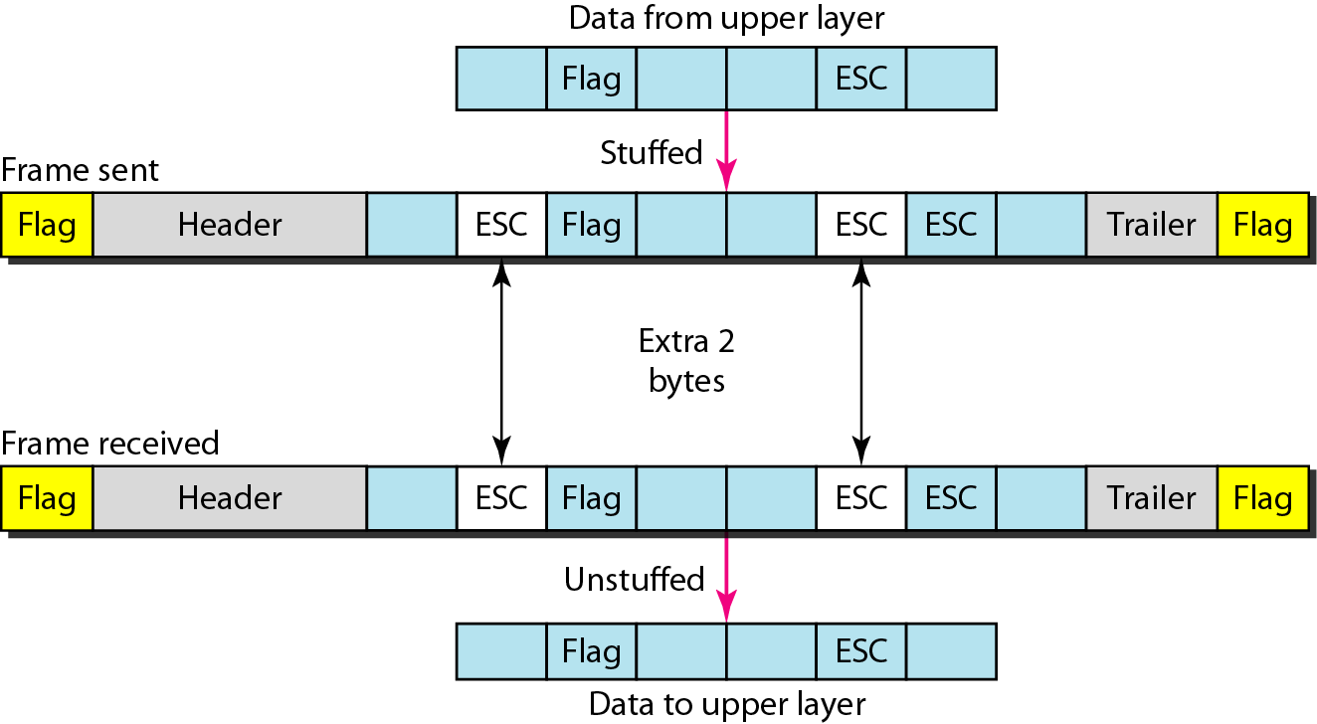
Byte stuffing and unstuffing
Byte stuffing is the process of adding 1 extra byte whenever there is a flag or escape character in the text

Slide 10
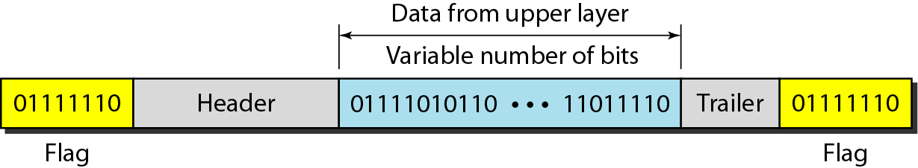
Framing: bit-oriented framing
special bit sequences (flag bits) used with bit stuffing
It was developed for HDLC (Highlevel Data Link Control) protocol
Each frame begins and ends with a special bit pattern, 01111110 or 0x7E in hexadecimal (a flag byte)

Slide 11
Framing: bit-oriented framing
whenever the sender’s data link layer encounters five consecutive 1s in the data, it automatically stuffs a 0 bit into the outgoing bit stream so that the receiver does not mistake the pattern 01111110 for a flag. This process is called Bit Stuffing.
This bit stuffing is analogous to byte stuffing, in which an escape byte is stuffed into the outgoing character stream before a flag byte in the data
When the receiver sees five consecutive incoming 1 bits, followed by a 0 bit, it automatically de-stuffs (i.e., deletes) the 0 bit

Slide 12
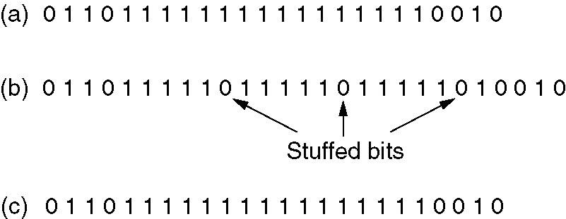
Framing: bit-oriented framing
Bit stuffing
(a) The original data
(b) The data as they appear on the line
(c) The data as they are stored in receiver’s memory after de-stuffing

Slide 13
Data link layer divided into two functionality-oriented sub-layers
Data link control and
Medium Access Control
The Medium Access Control Sub-layer

Slide 14

Medium Access Control
There are Two categories of network links
Those using point-to-point connections
Those using broadcast channels
In any broadcast network
How to determine who gets to use the channel when there is competition for it?
Broadcast channels are sometimes referred to as multi-access channels or random access channels
Multiple-access problem: when a channel is shared among many nodes, the problem arises to when each node should access the channel
Protocols used to determine who goes next on a multi-access channel belongs to MAC layer
Distributed system is the key matter which makes this issue hard as there is no one in-charge in the system

Slide 15
MAC Protocols
MAC is important in LANs, particularly critical to the performance of wireless LANs as wireless is naturally an open, shared, and broadcast medium/channel
MAC allows several stations connected to the transmission medium to transmit over it and to share its capacity
A MAC protocol is used to resolve potential contention and collision when using the communication medium
MAC protocols define rules to force distributed nodes to access wireless medium in an orderly and efficient manner

Slide 16
Ingredients of MAC Protocols
Carrier sense (CS)
Hardware capable of sensing whether transmission taking place in vicinity
Acknowledgments
When collision detection not possible, link-layer mechanism for identifying failed transmissions
Backoff mechanism
Method for estimating contention and deferring transmissions
Collision detection (CD)
Hardware capable of detecting collisions
Collision avoidance (CA)
Protocol for avoiding collisions

Slide 17
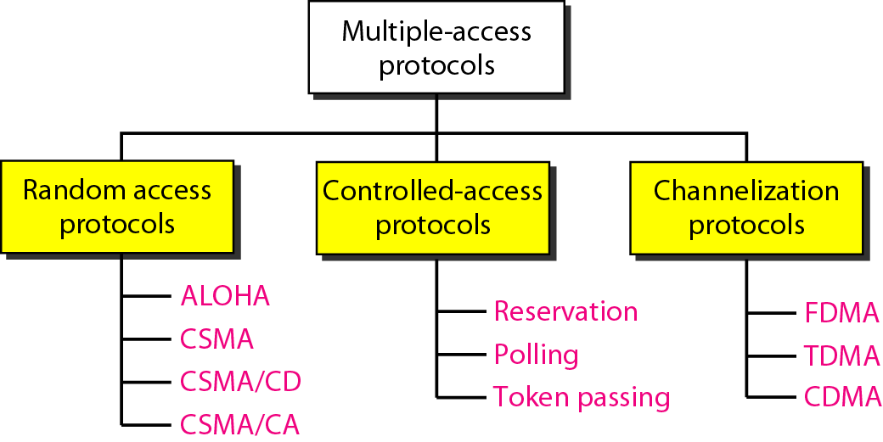
Taxonomy of multiple-access protocols

Slide 18
Random multiple access protocols
In random access or contention methods,
No station is superior to another station and
No station is assigned the control over another
No station permits, or does not permit, another station to send
At each instance, a station that has data to send uses a procedure defined by the protocol to make a decision on whether or not to send
A station can transmit
When it desires
Provided it obeys the mechanism defined by the protocol
Such as verification of state of medium

Slide 19
Random multiple access protocols
Stations transmit without any schedule
Methods are called random access because
transmission is random among the stations
Also called contention methods
Stations have competition to access the common medium that can lead to conflicts
no rules specify which station should transmit next
Access collision
If more than one stations try to send
Frames can be either destroyed or modified

Slide 20
Random multiple access protocols
To avoid access collision or resolve when it happens, a node follows a procedure that tackles the following:
When to access the medium
What to do if medium busy
How to determine the transmission failure or success
What to do in the situation of collision

Slide 21
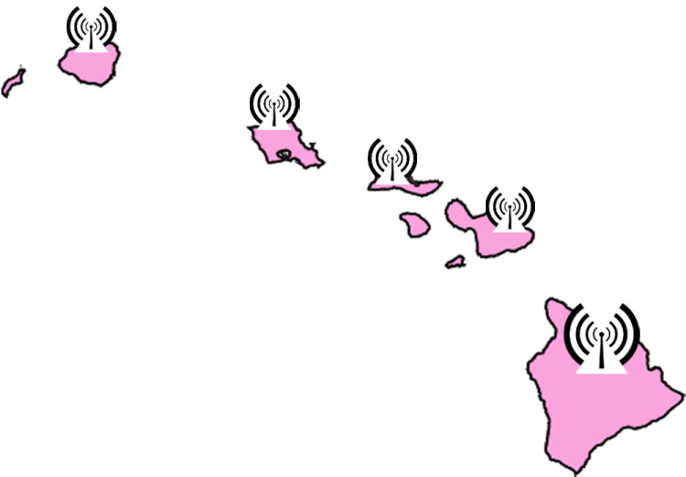
ALOHA Network (Areal LOcations of Hazardous Atmospheres)
Norm Abramson devised a new protocol at the University of Hawaii for multiple access
When should nodes send?
computer network connecting the Hawaiian islands in the late 1960s with wireless links
Use of very simple procedure: Multiple access
All random access methods evolved from ALOHA
Principal of pure ALOHA:
If you have data to send, send the data
If the message collides with another transmission (no ACK received), sender waits random time before trying again (resend)

Slide 22
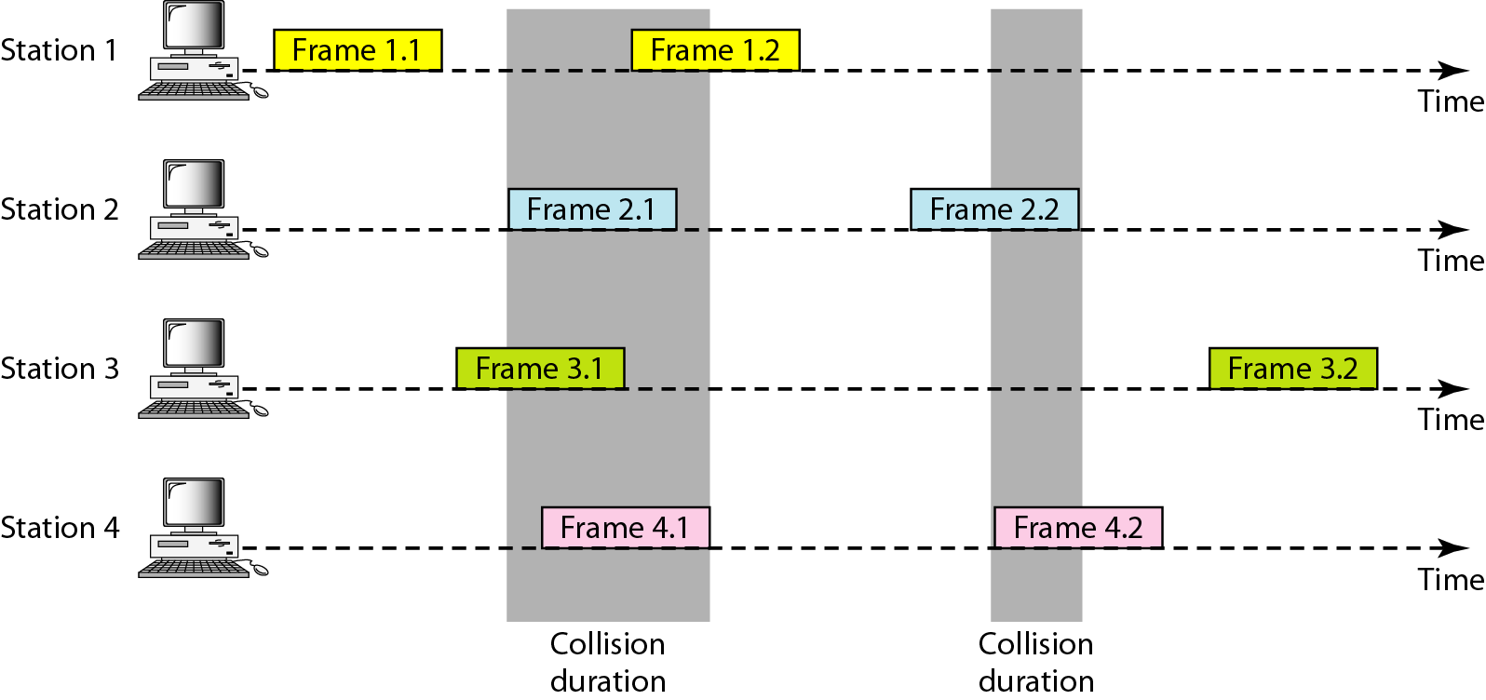
Frames in a pure ALOHA network:
4 stations each with 2 frames contending with one another for access to the shared channel

Slide 23
Pure ALOHA
Even if one bit of a frame coexists on the channel with one bit from another frame: There is a collision
Resend the frames that have been destroyed during transmission
It relies on ACKs from receiver
If no ACK received after a time-out period, then assumes that frame has been destroyed and resend the frame
If all collided stations retransmit after time out: Frame may collide again
Pure ALOHA dictates that each station waits a random amount of time (back-off time:T_{B}) before resending its frame
The randomness helps in avoiding more collisions
To prevent congestion of the channel with retransmitted frames
a station must give up after a maximum number of retransmission attempts K_{max} and try later

Slide 24
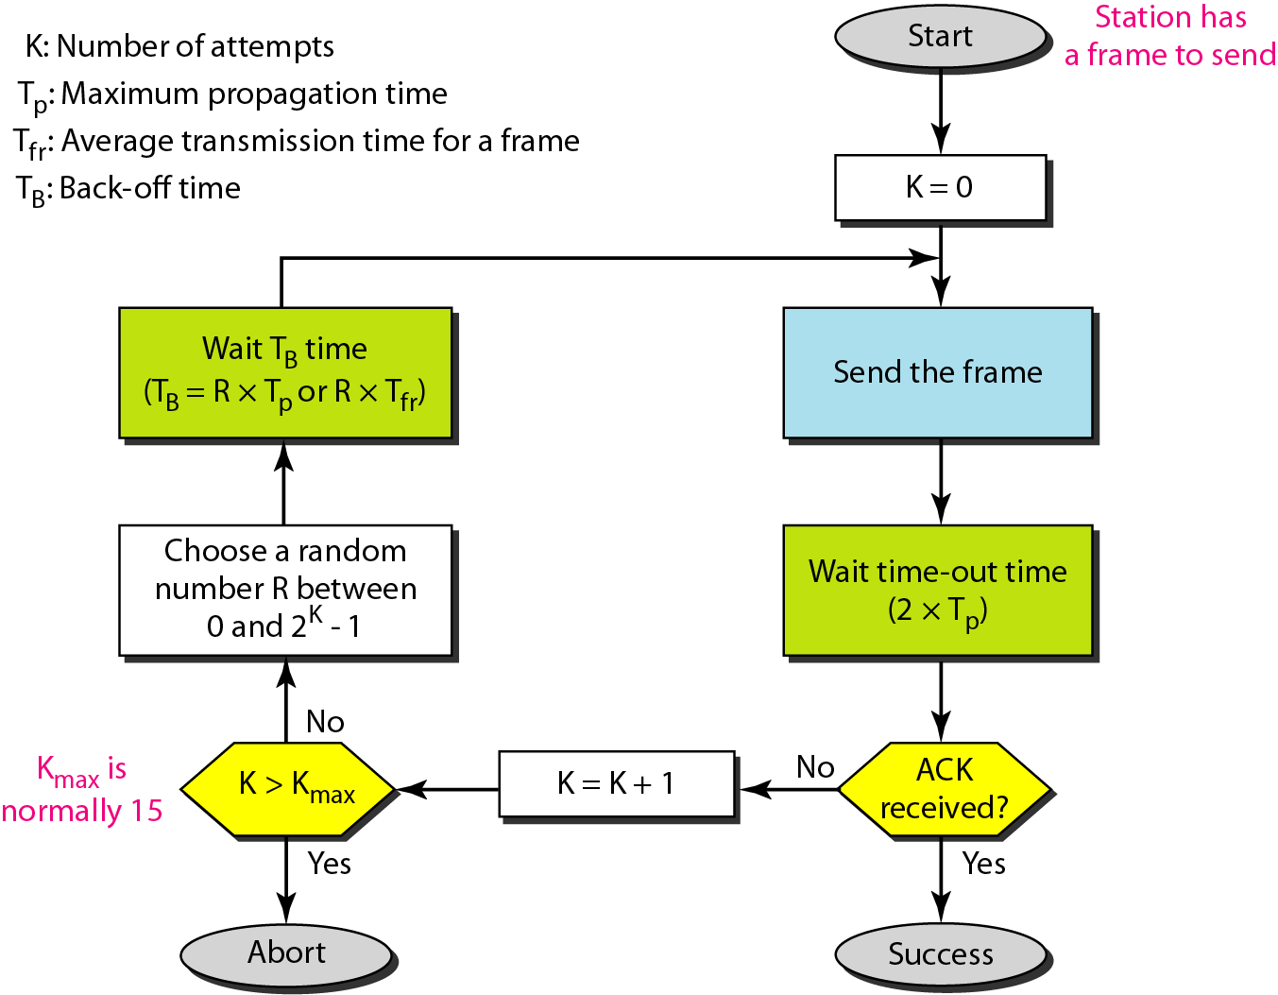
Procedure for pure ALOHA protocol

Slide 25
Pure ALOHA: Example
The stations on a wireless ALOHA network are a maximum of 600 km apart. If we assume that signals propagate at 3 × 108 m/s, we find
➢ Tp = (600 × 103 ) / (3 × 108 ) = 2 ms
➢ Value of TB for different values of
K = 1, 2, 3
➢ For K = 2,
➢ the range is {0, 1, 2, 3}
➢ This means that TB can be 0, 2, 4, or 6 ms, based on the outcome of the random variable
➢ For K = 3,
➢ the range is {0, 1, 2, 3, 4, 5, 6, 7}
➢ This means that TB can be 0, 2, 4, . . . , 14 ms based on the outcome of the random variable

Slide 26
Pure ALOHA
Under what conditions will frame A arrive undamaged?
Let Tfr be the time required to send one frame
If any other user has generated a frame between t-Tfr and t, the end of that frame (here B) will collide with beginning of A
Similarly, any other frame started between t and t+Tfr will bump into the end of frame A for station B’s frame to be transmitted without any problems, nobody has to be transmitting from time t-Tfr and time t+Tfr, which is 2 times the frame transmission time So Pure ALOHA vulnerable time = 2 x Tfr

Slide 27
Example
A pure ALOHA network transmits 200-bit frames on a shared channel of 200 kbps. What is the requirement to make this frame collision-free?
Answer
Average frame transmission time
Tfr = 200 bits/200 kbps = 1 ms (data/capacity)
The vulnerable time is 2 × 1 ms = 2 ms
This means no station should send later than 1 ms when this station
starts transmission and It means previous transmission must end before its start no station should start sending during the 1 ms period that this station is sending

Slide 28
Pure ALOHA Example
On a wireless ALOHA network
stations are maximum 300 Km apart
Assume that signals propagate at 3 x 10⁸ m/s
Maximum propagation time= Tp = ?
Backoff time = T_{B} = ? If K = 1, 2,3
What will be the maximum propagation time and backoff time if stations are 900 Km apart

Slide 29
Slotted ALOHA
Slotted ALOHA was invented to improve the efficiency of pure ALOHA
In slotted ALOHA, time is divided into slots of T_{fr} seconds (average transmission time for a frame) and force the station to send only at the beginning of the time slot
A station must wait until the beginning of the next time slot
If it misses to transmit at the start of a time slot
Possibility of collision
If two stations try to send at the start of the same time slot

Slide 30
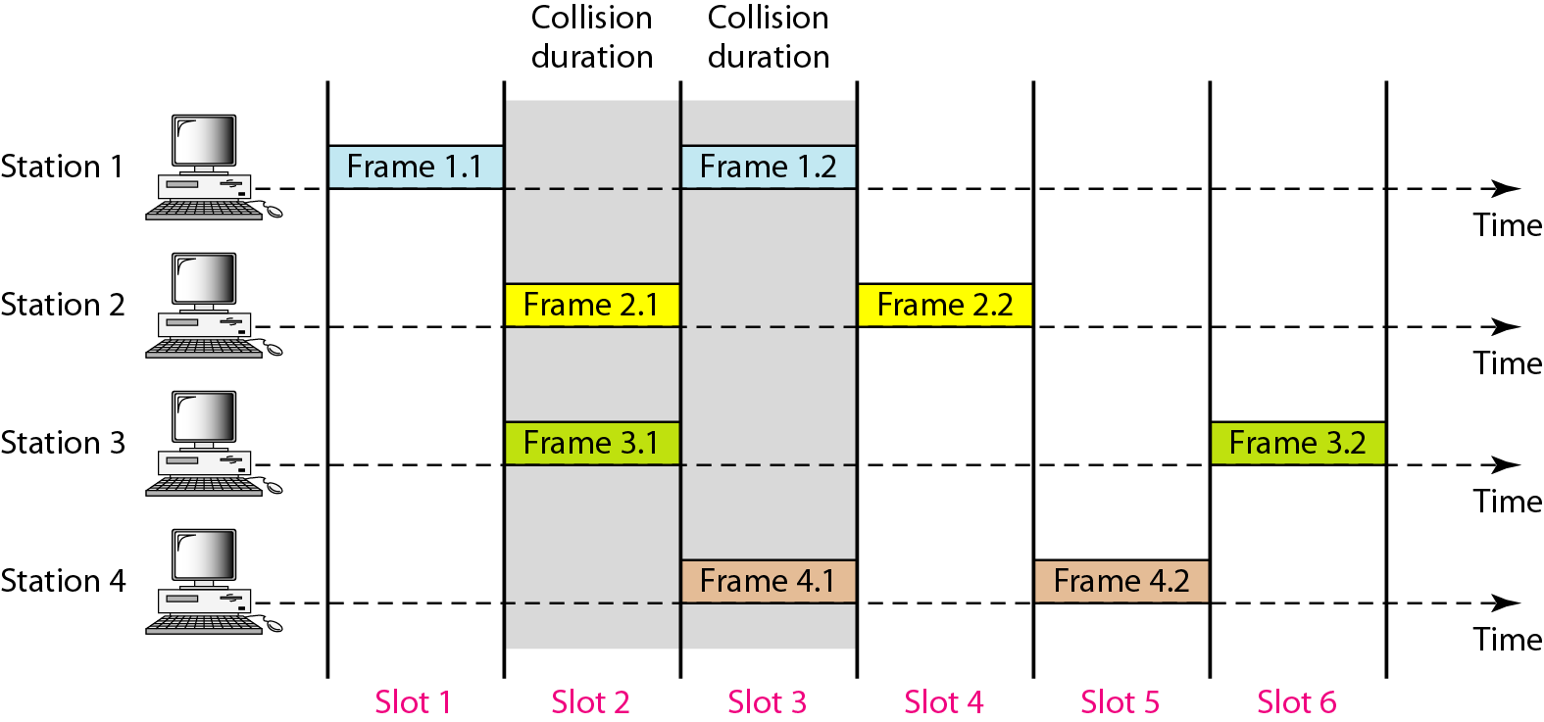
Frames in a slotted ALOHA network

Slide 31
CSMA (Carrier Sense Multiple Access)
CSMA protocol was developed to minimize the chances of collision, so as to improve the performance
Improves ALOHA by listening for activity before we send (carrier sense)
Protocols in which station listen for a carrier (such as an electrical bus, or a band of the electromagnetic spectrum) and act accordingly are called carrier sense protocols
Collision chances can be reduced to great extent
if a station senses the channel before trying to use it
So CSMA is based on the principal of sense before transmit
If channel sensed idle, transmit entire frame
If channel sensed busy, defer transmission
Human analogy: don’t interrupt others

Slide 32
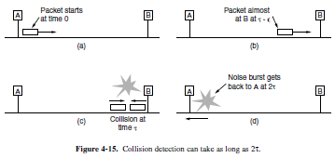
CSMA
CSMA cannot eliminate the possibility of collision completely
it can only reduce the chances of collision
Collision is possible if two nodes send instantaneously (simply)
BUT a collision is still possible even if they send at slightly different times
it takes time for frames to propagate along the medium
The propagation delay is the major concern for the chances of collision

Slide 33
CSMA
Let station B senses the medium at t₁ and finds it idle,
so it sends a frame
At time t₂ (t₂> t_{I})‘station C senses the medium and finds it idle
because, at this time, the first bits from station B have not reached station C
So, C also sends a frame
The two signals collide and both frames are destroyed
CSMA Access Modes
1-persistent CSMA
Non-persistent CSMA
P-persistent CSMA

Slide 34
1-Persistent CSMA
station that wants to transmit data, continuously senses the channel to check whether it is idle or busy
If the channel is busy
the station continues sensing until it becomes idle
When an idle channel is detected
The station immediately transmits the frame with probability 1 (so called1-persistent CSMA)
It has the highest chance of collision
two or more stations may find channel to be idle at the same time and transmit their frames
When the collision occurs, the stations wait a random amount of time and start all over again
This mode is used in CSMA/CD

Slide 35
Non-Persistent CSMA
A station that has a frame to send senses the channel
If the channel is idle,
it sends immediately
If the channel is busy,
it waits a random amount of time, and
then senses the channel again
In non-persistent CSMA the station does not continuously sense the channel for the purpose of capturing it when it detects the end of precious transmission

Slide 36
P-Persistent CSMA
This method is used when channel has time slots such that the time slot duration is equal to or greater than the maximum propagation delay time
Whenever a station becomes ready to send, it senses the channel
If channel is busy, station waits until next slot
If the channel is idle, it transmits with a probability p
With the probability q=1-p, the station then waits for the beginning of the next time slot
If the next slot is also idle, it either transmits or wait again with probabilities p and q respectively
This process is repeated till either frame has been transmitted or another station has begun transmitting
In case of the transmission by another station, the station act as though a collision has occurred and it waits a random amount of time and starts again
This mode is used in CSMA/CA
Advantage: it reduce collision chances and improve the efficiency of the network

Slide 37
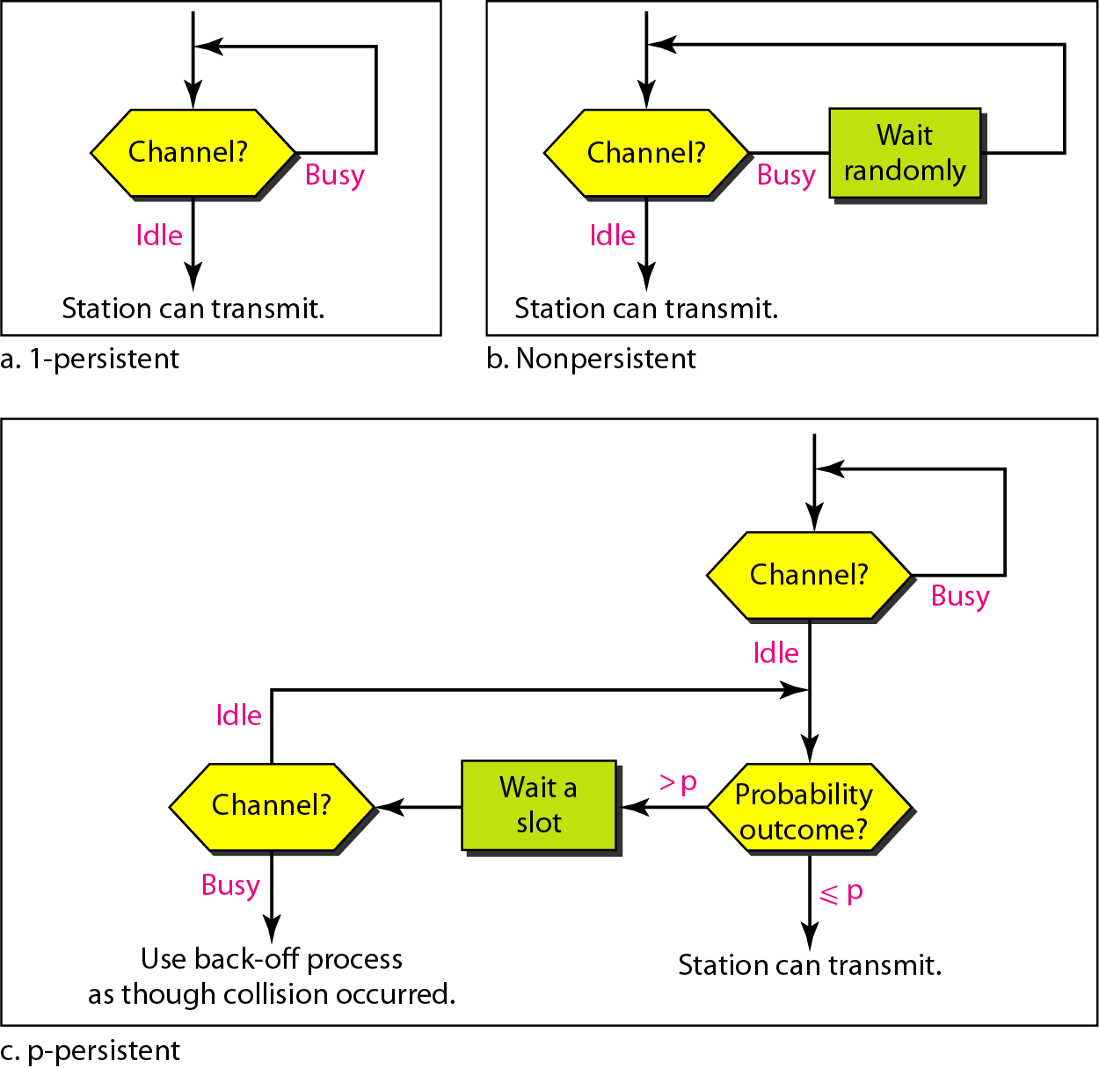
Flow diagram for three persistence methods

Slide 38
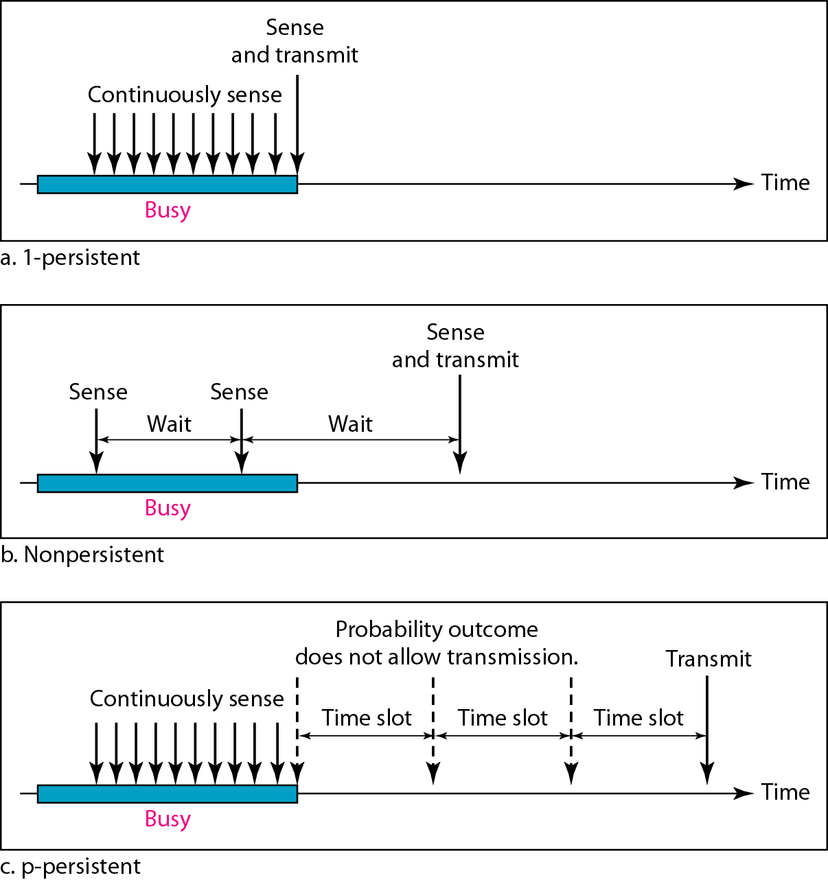
Behavior of three persistence methods

Slide 39
CSMA does not specify any procedure after collision
CSMA/CD enhances the algorithm to handle the collision

Slide 40
CSMA/CD (carrier sense multiple access/ collision detection)
Persistent and non-persistent CSMA protocols are definitely an improvement over ALOHA because they ensure that no station begins to transmit while the channel is busy
However, if two stations sense the channel to be idle and begin transmitting simultaneously, their signals will still collide.
Another improvement (on top of ALOHA) is for the stations to quickly detect the collision and abruptly stop transmitting, (rather than finishing them).This scheme saves time and bandwidth

Slide 41
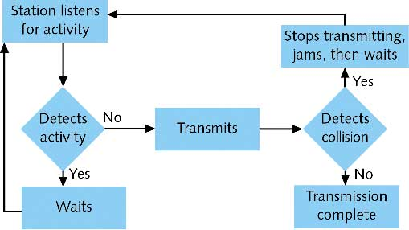
CSMA/CD
When a sender detects a collision, it sends a “jam signal”.
Make sure that all nodes are aware of the collision
Length of the jam signal is 32 bit times
In CSMA/CD, stations abort their transmission when they detect a collision e.g., Ethernet, IEEE802.3
It is not applicable to wireless systems

Slide 42
CSMA/CD: Procedure
Node has a frame to transmit
Sense the medium
If busy (not idle): wait until becomes free
If idle: transmit
After transmission, check weather collision has occurred
If collision has detected
Send a jam signal
Increment retransmission counter
Check maximum number of retransmission attempts. If yes, abort transmission
Based on number of collisions, calculate random backoff time and wait that time
Repeat from step 2 again
If no collision detected, transmission is successful
Retransmission counters are reset and end frame transmission

Slide 43
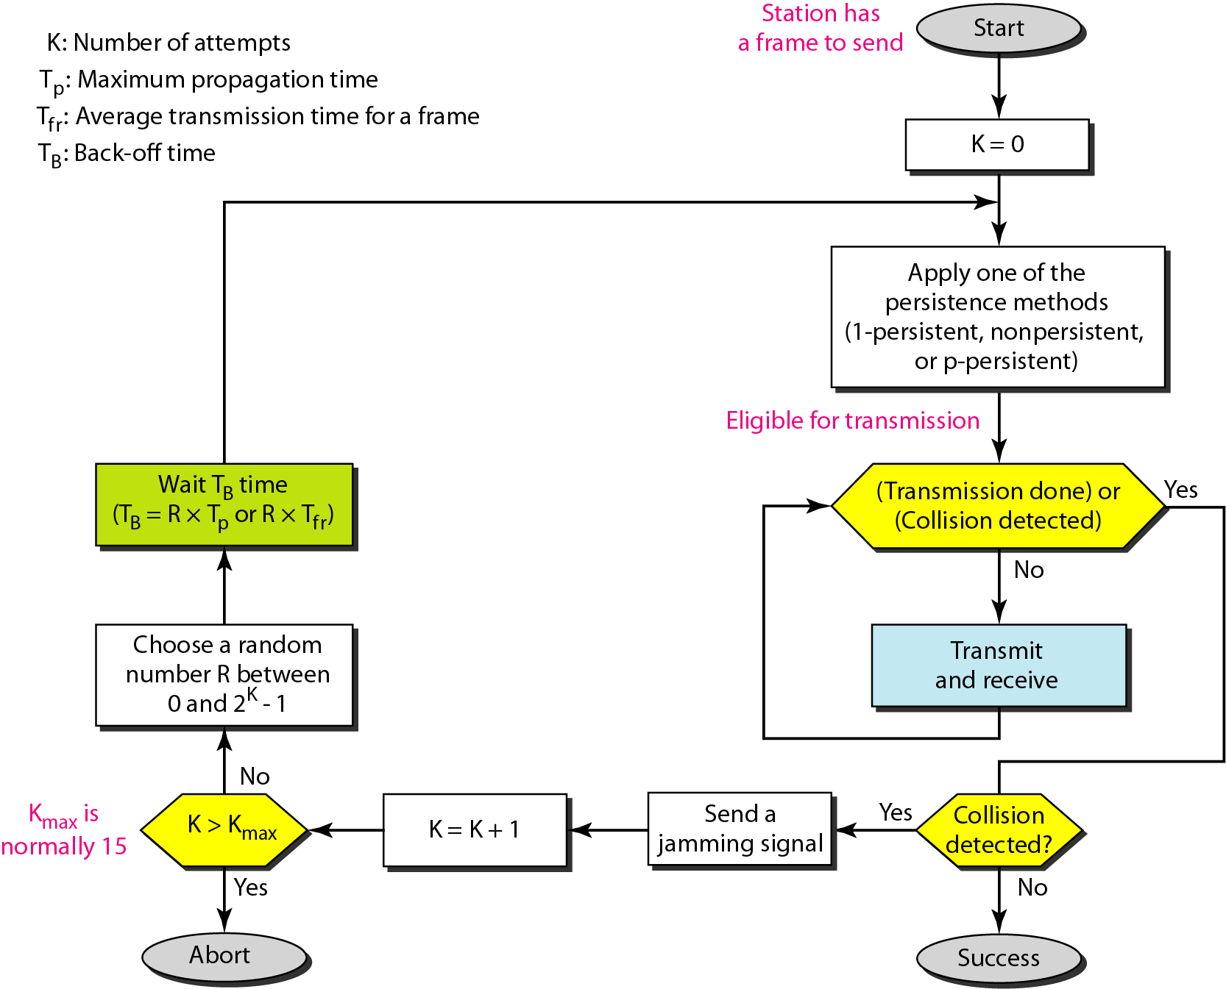
Flow diagram for the CSMA/CD

Slide 44
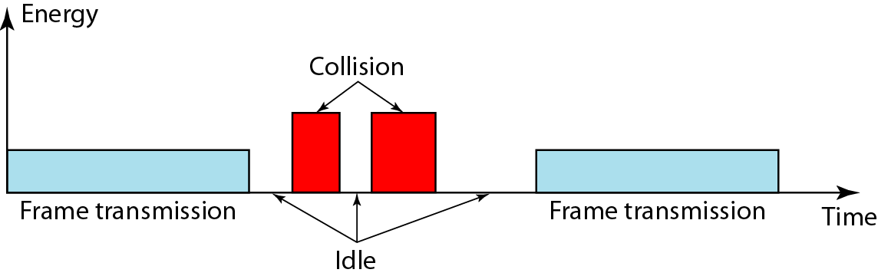
Energy level during transmission, idleness, or collision
level of energy in a channel can have three values
Zero: the channel is idle
Normal: The station has successfully captured the channel and is sending its frame
Abnormal: there is a collision and the level of the energy is twice the normal level
station that has a frame to send or is sending a frame needs to monitor the energy level to determine if the channel is idle, busy, or in collision mode

Slide 45
Collision detection: If the signal, the sender reads back, is different from the signal it is putting out, it knows that a collision is occurring
In fact, a received signal must not be tiny compared to the transmitted signal
In CSMA/CD : a station needs to be able to receive while transmitting to detect a collision
When there is no collision, the station receives one signal: its own signal
When there is a collision, the station receives two signals: its own signal and the signal transmitted by a second station
To distinguish between these two cases, the received signals in these two cases must be significantly different

Slide 46
In a wired network, the received signal has almost the same energy as the sent signal because
So in a collision, the detected energy almost doubles
Popular CSMA scheme and its variant CSMA/CD developed for wired networks
Can not be used directly in wireless networks

Slide 47
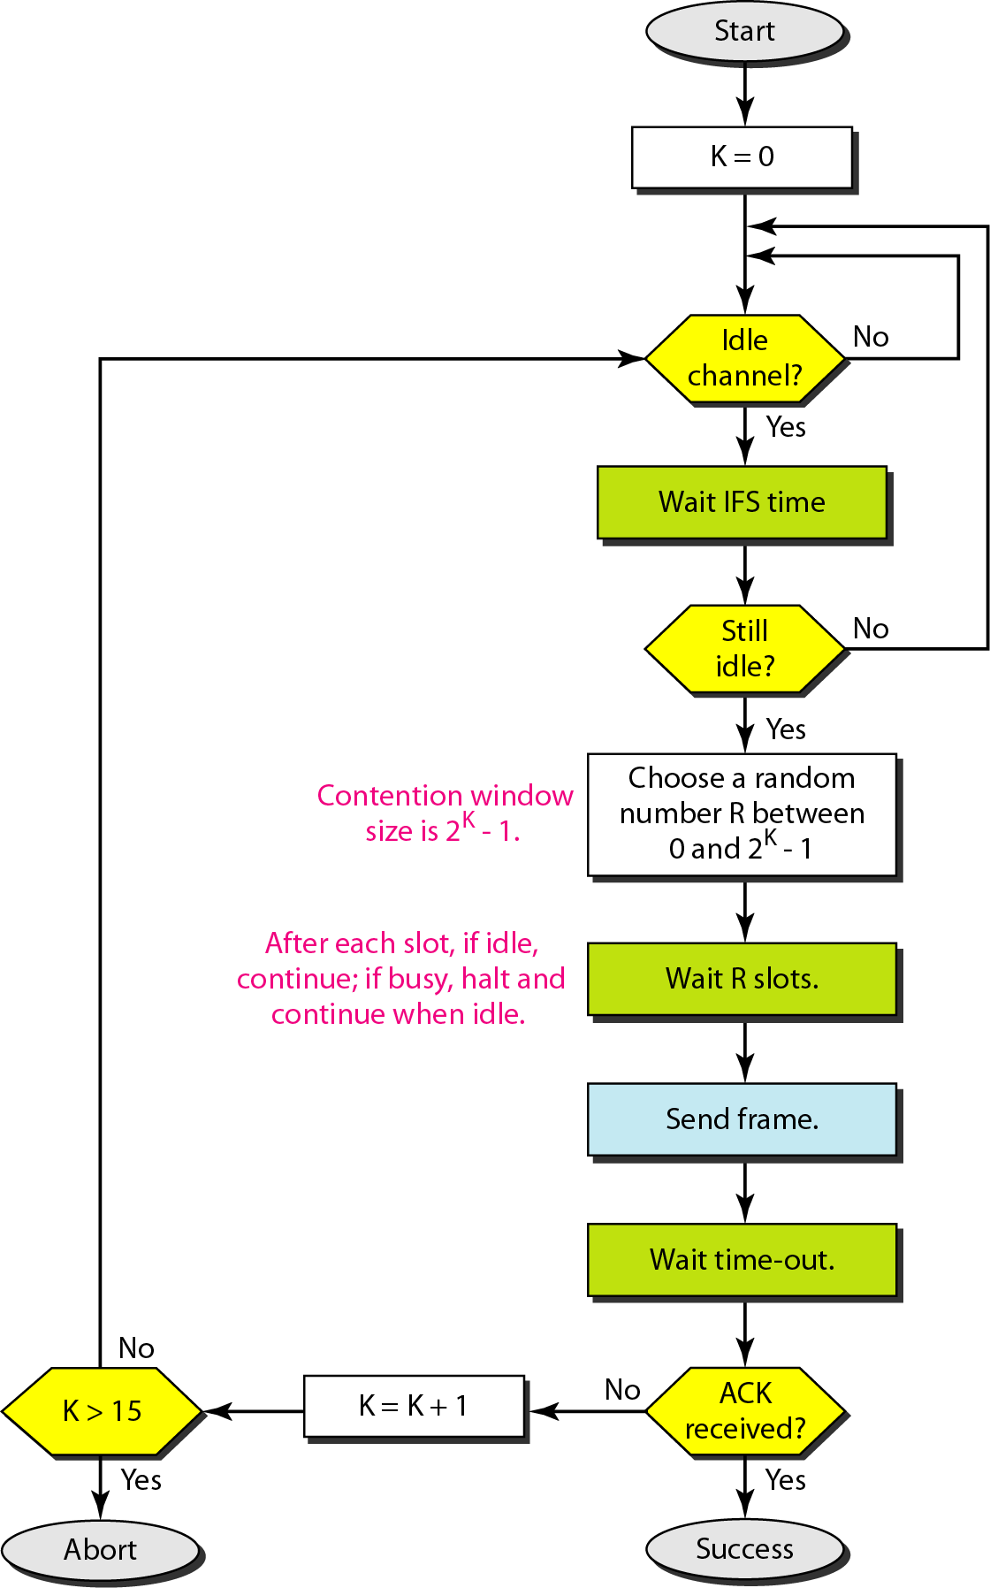
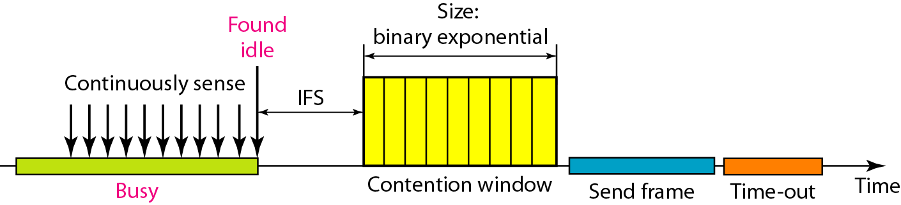
CSMA/Collision Avoidance
Timing in CSMA/CA

